Slide 1
Dimension reduction and feature extraction
using wavelet method
A rather interesting MA611 project
by Ryan Zhang, Danjie Zhao, Yuge Xiao, Jess Zhang

Slide 2
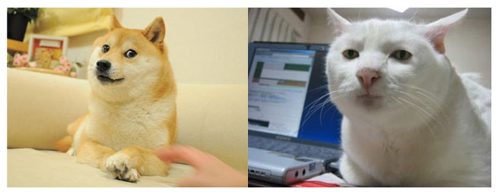
Is it a DOG or a CAT ?
Wow
so hard
what r
you doing
Concern
w-a-v-e-l-e-t
is not for this task
This is serious

Slide 3
Why build a classifier for dog and cat ?

Slide 4
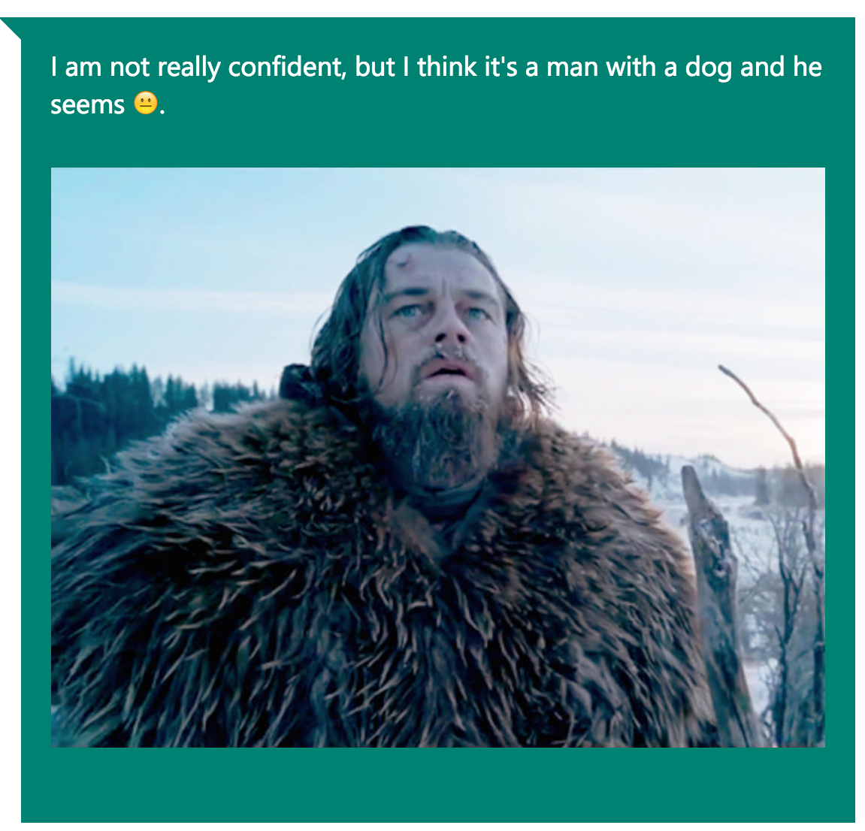
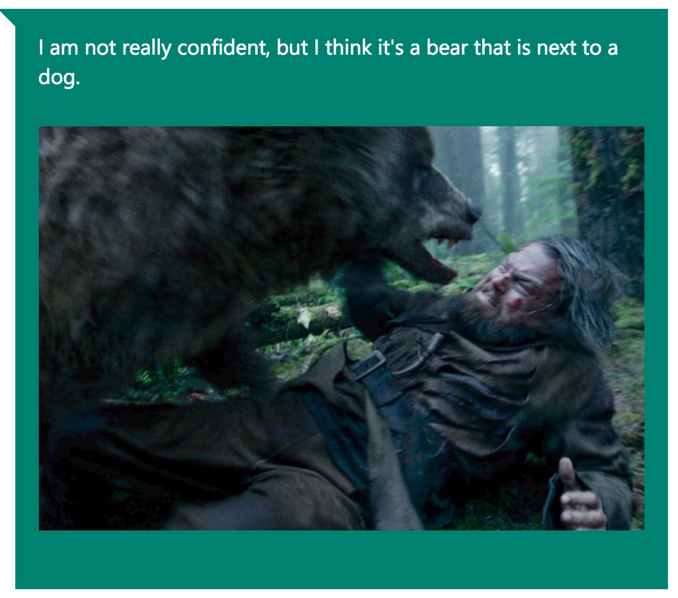
Why build a classifier for dog and cat ?
Image recognition is a difficult task for computer
Microsoft Artificial Intelligence: captionbot

Slide 5
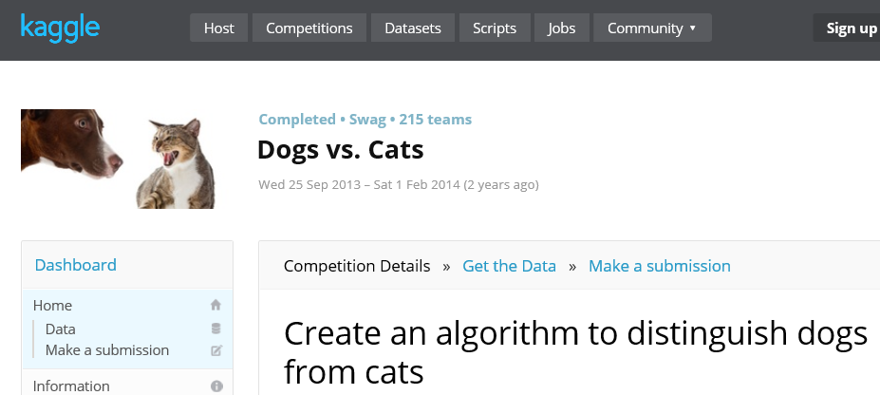
Why build a classifier for dog and cat ?
Image recognition is a difficult task for computer
So many serious people trying to solve it

Slide 6
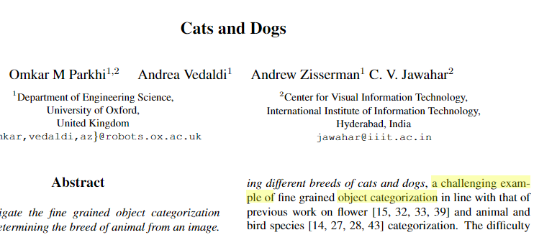
Why build a classifier for dog and cat ?
Image recognition is a difficult task for computer
So many serious people trying to solve it
And it turned out to be challenging....
Wavelet !

Slide 7
Approach
Data
Collection
Data
Processing
Model
Building
Final
Product
Testing

Slide 8
Approach
The might be a difference:
Data
Collection
Data
Processing
Model
Building
Final
Product
Testing
where your
time series model
is used in

Slide 9
Approach
The might be a difference:
Data
Collection
Data
Processing
Model
Building
Final
Product
Testing
where your
time series model
is used in
where our
time series model (wavelet)
is used in

Slide 10
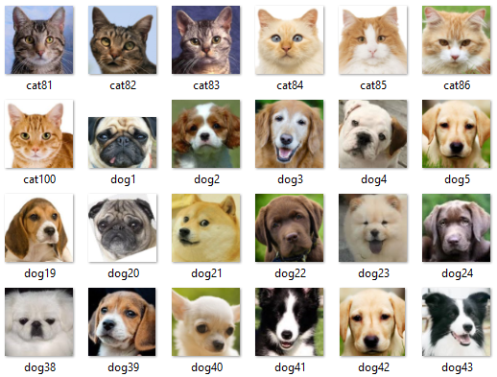
Approach
Data
Collection
Data
Processing
Model
Building
Final
Product
Testing
100 Cats
100 Dogs

Slide 11
Approach
Data
Collection
Data
Processing
Model
Building
Final
Product
Testing
100 Cats
100 Dogs
doge included

Slide 12
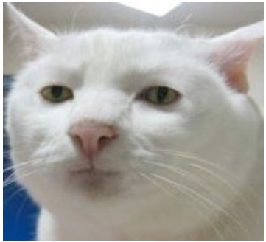
Approach
Data
Collection
Data
Processing
Model
Building
Final
Product
Testing
Original
Image

Slide 13
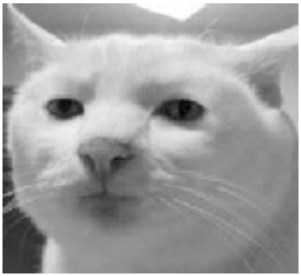
Approach
Data
Collection
Data
Processing
Model
Building
Final
Product
Testing
Original
Image
Greyscale
Resize
Renormalize

Slide 14


Approach
Data
Collection
Data
Processing
Model
Building
Final
Product
Testing
Original
Image
Greyscale
Resize
Renormalize
Magic!!!

Slide 15
Approach
Data
Collection
Data
Processing
Model
Building
Final
Product
Testing
Original
Image
Greyscale
Resize
Renormalize
Magic!!!
Wavelet
* not exactly what we get simply an illustration

Slide 16
Approach
We tuned a random forest model using cross validation It will be used for prediction
Data
Collection
Data
Processing
Model
Building
Final
Product
Testing

Slide 17
Approach
We tuned a random forest model using cross validation It will be used for prediction
We also built a KNN model For finding similar cats or dogs (not very good though, just for fun)
Data
Collection
Data
Processing
Model
Building
Final
Product
Testing

Slide 18
Approach
The overall OOB estimates for error rate is 24%
Data
Collection
Data
Processing
Model
Building
Final
Product
Testing

Slide 19
Approach
Data
Collection
Data
Processing
Model
Building
Final
Product
Testing
A web application which we will show later on

Slide 20

Welcome to the magician bootcamp

Slide 21
How to treat image like a time series

Slide 22

How to treat image like a time series
Excuse me?

Slide 23

How to treat image like a time series
This is a image of the number 1

Slide 24
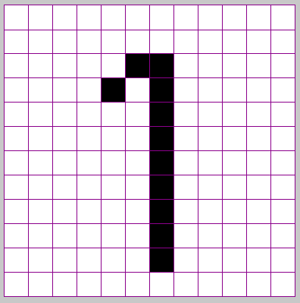
How to treat image like a time series
Essentially, it is a 12 by 12 grid filled with ink
12
12

Slide 25
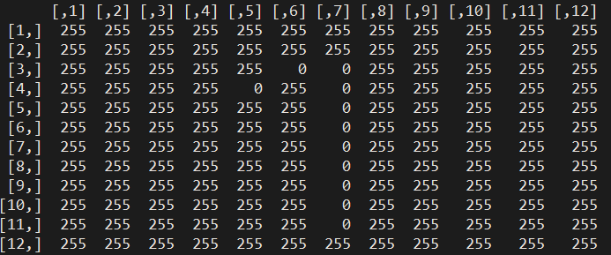
How to treat image like a time series
Turned out to be a 12 by 12 matrix in computer

Slide 26
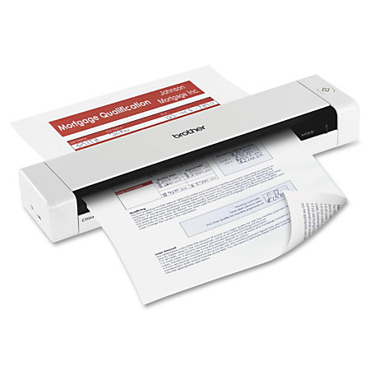
How to treat image like a time series
Forget that you are a human and
pretend that you are a scanner just for now

Slide 27
How to treat image like a time series
12
to the eyes of
12
is: 255,255,255,255,...,255,0,0,255,255,...,255,0,255,0,255,255,...,255
144 numbers

Slide 28
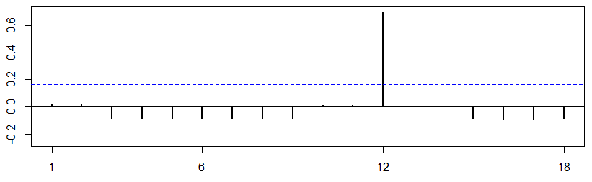
Take a look at the correlogram

Slide 29

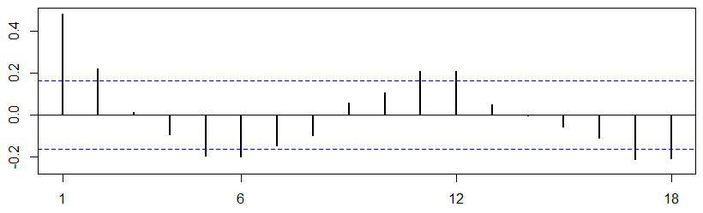
Take a look at the correlograms

Slide 30
What number is it?
Hey, this might be a 1

Slide 31
What number is it?
Hey, this might be a 1
Something is telling me
this might be a 3

Slide 32
Pros and Cons
This is definitely a 1
(used 144 pieces of information)

Slide 33
Pros and Cons
This is definitely a 1
(used 144 pieces of information)
Hey, this might be a 1
(used 18 pieces of information)

Slide 34

Why not directly build model with all information?
My macbook pro is powerful

Slide 35
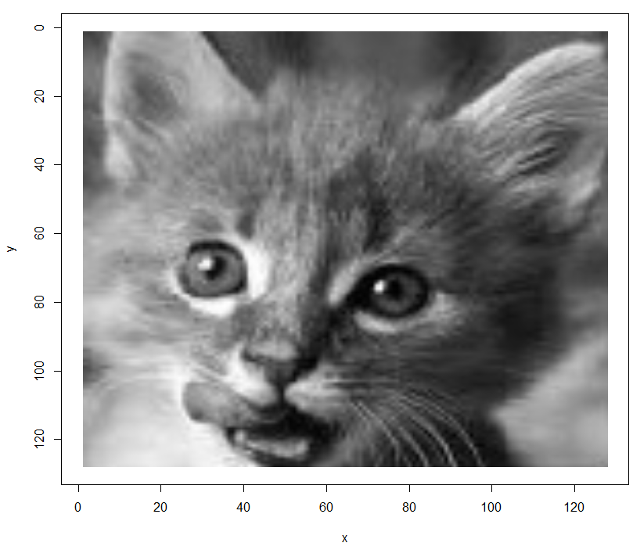
Why not directly build model with all information?
Our image is actually very small already…
128
128*128=16384
128

Slide 36
Why not directly build model with all information?
Here is the dimension of our training data
Cat1 255 255 255 … 255 255
Cat2 121 126 117 … 117 119
⋮ ⋮ ⋮ ⋮ ⋱ ⋮ ⋮
Cat100 255 255 255 … 255 255
Dog1 185 184 184 … 184 183
Dog2 138 130 132 … 92 64
⋮ ⋮ ⋮ ⋮ ⋱ ⋮ ⋮
Dog100 178 179 180 … 181 181
200
16384

Slide 37
Why not directly build model with all information?
The curse of dimensionality
Cat1 255 255 255 … 255 255
Cat2 121 126 117 … 117 119
⋮ ⋮ ⋮ ⋮ ⋱ ⋮ ⋮
Cat100 255 255 255 … 255 255
Dog1 185 184 184 … 184 183
Dog2 138 130 132 … 92 64
⋮ ⋮ ⋮ ⋮ ⋱ ⋮ ⋮
Dog100 178 179 180 … 181 181
200
16384

Slide 38

Why not directly build model with all information?
Let’s just fit a logistic regression on this thing…
Model <- glm(imageLabels~imageMatrix, family = binomial)
CHALLENGE
ACCEPTED

Slide 39
Why not directly build model with all information?
Tons of warning messages

Slide 40
Why not directly build model with all information?
Tons of warning messages
Huge number of NAs for coefficients

Slide 41
Why not directly build model with all information?
Tons of warning messages
Huge number of NAs for coefficients
Even in-sample prediction is tragic
Actual
Cat Dog
Cat 36 37
Dog 64 63
Predicted

Slide 42

Why not directly build model with all information?
Tons of warning messages
Huge number of NAs for coefficients
Even in-sample prediction is tragic
Actual
Cat Dog
Cat 36 37
Dog 64 63
Predicted

Slide 43
What wavelet can buy us?
Reduced the dimensionality of the problem
C1 C2 … Ck
Cat1 -411 313 … 563
Cat2 -750 715 … -595
⋮ ⋮ ⋮ ⋱ ⋮
Cat100 -447 -484 … 295
Dog1 -819 820 … 299
Dog2 -8 317 … 271
⋮ ⋮ ⋮ ⋱ ⋮
Dog100 295 934 … 310
Cat1 255 255 255 … 255 255
Cat2 121 126 117 … 117 119
⋮ ⋮ ⋮ ⋮ ⋱ ⋮ ⋮
Cat100 255 255 255 … 255 255
Dog1 185 184 184 … 184 183
Dog2 138 130 132 … 92 64
⋮ ⋮ ⋮ ⋮ ⋱ ⋮ ⋮
Dog100 178 179 180 … 181 181
200
200
16384
k
where C1,C2,...,Ck are wavelet decomposition coefficients
and k << 16384

Slide 44
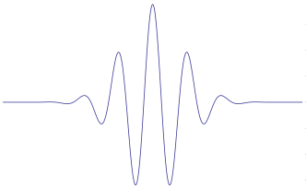
What is wavelet?
wavelet means small waves
t

Slide 45
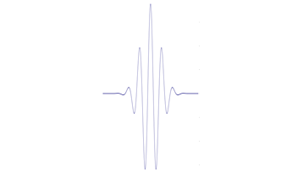
What is wavelet?
You can scale a wavelet
scale
a
t
t

Slide 46
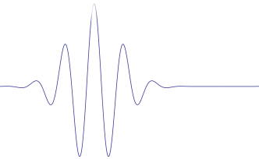
What is wavelet?
You can translate a wavelet
translate
b
t
t

Slide 47
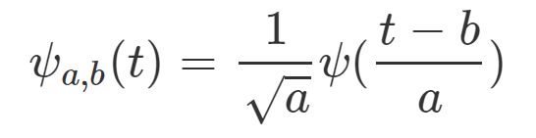
The only two formulas from us today...
The mother wavelet function

Slide 48
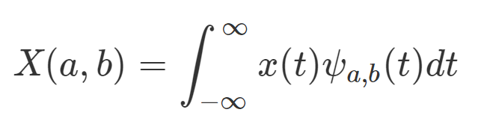
The only two formulas from us today...
The mother wavelet function
How to calculate coefficients

Slide 49
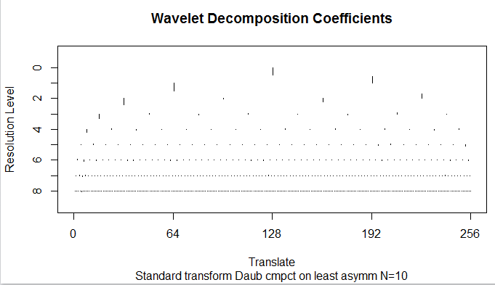
Wavelet decomposition coefficients

Slide 50
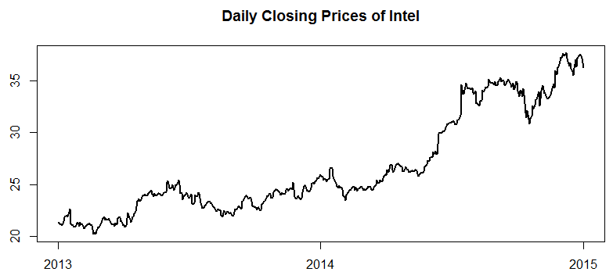
An analogy to regression decomposition

Slide 51
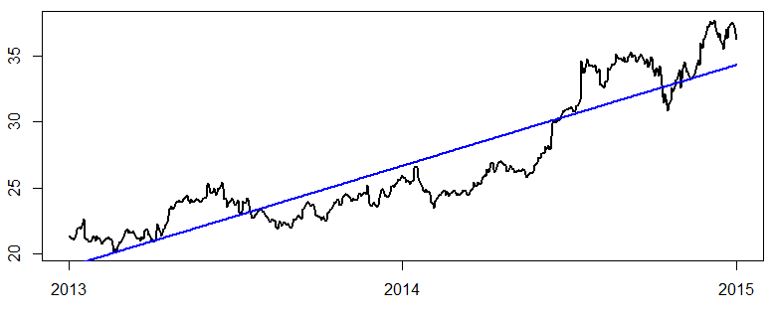
An analogy to regression decomposition
Simple linear regression:

Slide 52
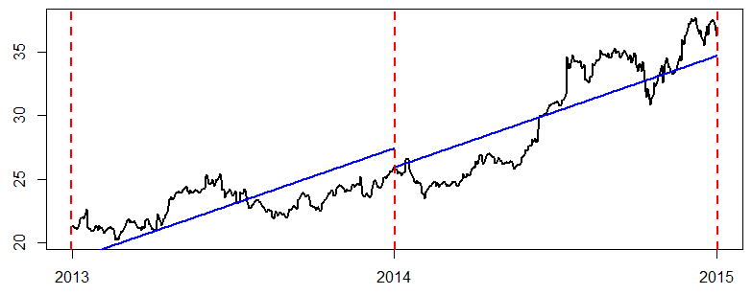
An analogy to regression decomposition
Use indicator variables for year

Slide 53
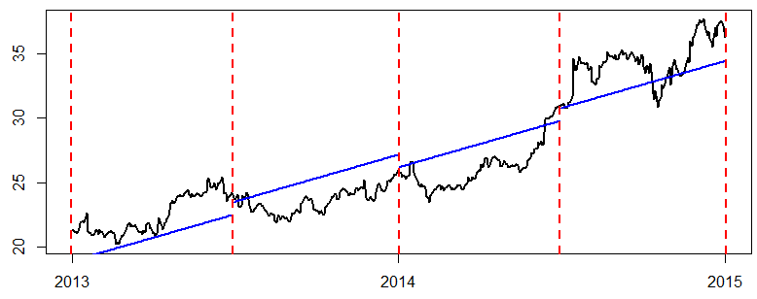
An analogy to regression decomposition
Use indicator variables for 6 months

Slide 54
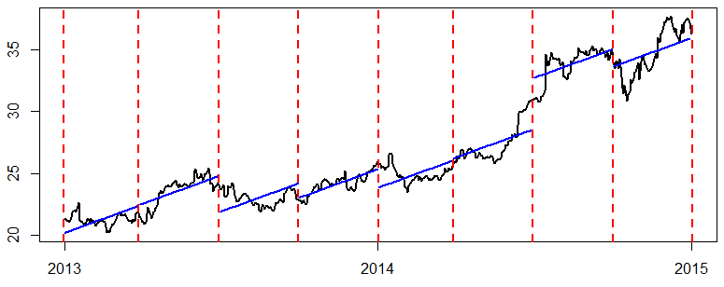
An analogy to regression decomposition
Use indicator variables for 3 months

Slide 55
Wavelet decomposition coefficients

Slide 56
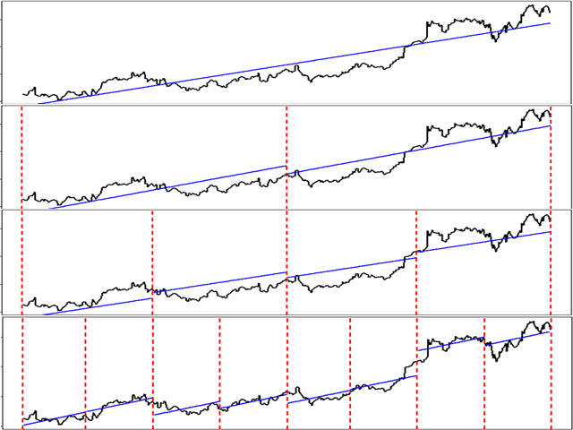
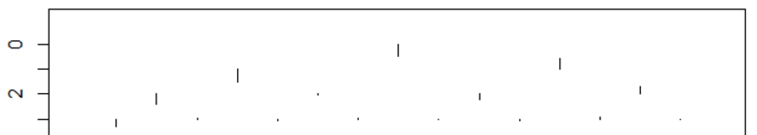
Putting them side by side

Slide 57
What wavelet bought for us
Reduced the dimensionality of the problem
C1 C2 … C256
Cat1 -411 313 … 563
Cat2 -750 715 … -595
⋮ ⋮ ⋮ ⋱ ⋮
Cat100 -447 -484 … 295
Dog1 -819 820 … 299
Dog2 -8 317 … 271
⋮ ⋮ ⋮ ⋱ ⋮
Dog100 295 934 … 310
200
256
C1, C2,...C256 are wavelet decomposition coefficients at the 8th scaling level

Slide 58
So we tuned a random forest model
OOB estimate of error rate: 24%
Confusion matrix:
cat dog class.error
cat 76 24 0.2400000
dog 24 76 0.2400000

Slide 59

So we tuned a random forest model
OOB estimate of error rate: 24%
Confusion matrix:
cat dog class.error
cat 76 24 0.2400000
dog 24 76 0.2400000

Slide 60

Wait, where is the magic?

Slide 61
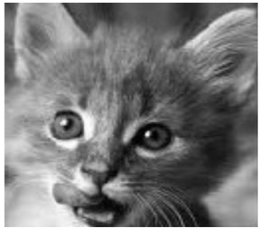
The truth is...

Slide 62
The truth is...

Slide 63
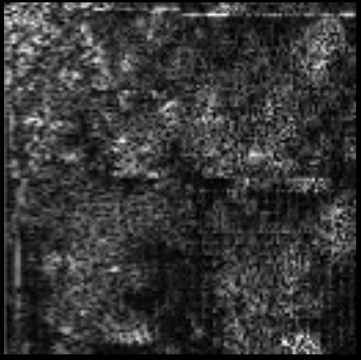
The truth is...

Slide 64

But don’t be discouraged...

Slide 65

But don’t be discouraged...
Because wavelet is a powerful tool

Slide 66
Demo time!

Slide 67
References
Parkhi O. M., et al. Cats and Dogs, IEEE International Conference on Computer Vision, 2011. http://www.robots.ox.ac.uk/~vedaldi/assets/pubs/parkhi12cat.pdf
Kaggle, Competition Dogs vs. Cats. https://www.kaggle.com/c/dogs-vs-cats
Microsoft, ASIRRA. http://research.microsoft.com/en-us/um/redmond/projects/asirra/
Microsoft, CaptionBot. https://www.captionbot.ai/
Nason, G. P. Wavelet Methods in Statistics with R. Springer, New York, 2008.
Kuhn M., Johnson K. Applied Predictive Modeling. Springer, New York, 2013.
Hastie, T., Tibshirani, R., Friedman, J. The Elements of Statistical Learning: Data Mining, Inference, and Prediction. Springer, New York, 2009.
Manian, V., Image Feature Extraction and Segmentation. http://www.ece.uprm.edu/~manian/ImageAnalysis4.pdf
Dong X. Y., et al. Discrete Wavelet Transform Based Feature Extraction for Tissue Classification Using Gene Expression Data. The Scientific World Journal, 2014.
Walker J., Handbook of Transforms and Data Compression. CRC Press, Boca Raton, 2000.

Slide 68
Thank you
and...
Questions?

